Slide 1


Melu-Akekue Barinatamkee
4th January, 2023

Slide 2

Outline
Executive Summary
Introduction
Methodology
Results
Conclusion
Appendix

Slide 3
Executive Summary
Summary of methodologies
Data collection
Data wrangling
EDA with data visualization
EDA with SQL
Building an interactive map with Folium
Building a Dashboard with Plotly Dash
Predictive analysis (Classification)
Summary of all results
EDA results
Interactive analytics
Predictive analysis

Slide 4
Introduction
Project background and context
SpaceX advertises Falcon 9 rocket launches on its website, with a cost of 62 million dollars; others providers cost upward of 165 million dollars each, much of the savings is because SpaceX can reuse the first stage.
Problems you want to find answers
The project task is to predict if the first stage of the SpaceX Falcon 9 rocket will land successfully

Slide 5

Section 1

Slide 6
Methodology
Executive Summary
Data collection methodology:
SpaceX Rest API
Web Scraping from Wikipedia
Perform data wrangling
One Hot Encoding data fields for Machine Learning and data cleaning of null values and irrelevant columns
Perform exploratory data analysis (EDA) using visualization and SQL
Perform interactive visual analytics using Folium and Plotly Dash
Perform predictive analysis using classification models
LR, KNN, SVM, DT models have been built and evaluated for the best classifier

Slide 7
Data Collection
The following datasets was collected:
SpaceX launch data that is gathered from the SpaceX REST API.
This API will give us data about launches, including information about the rocket used, payload delivered, launch specifications, landing specifications, and landing outcome.
The SpaceX REST API endpoints, or URL, starts with api.spacexdata.com/v4/.
Another popular data source for obtaining Falcon 9 Launch data is web scraping Wikipedia using BeautifulSoup.

Slide 8
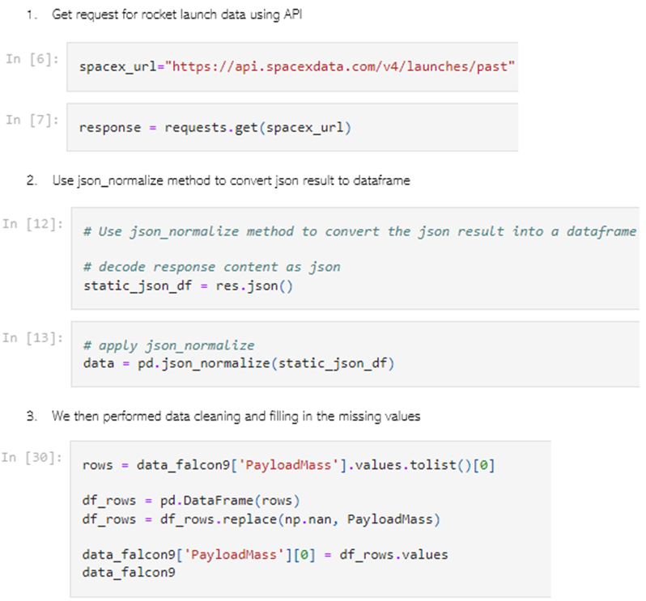
Data Collection – SpaceX API
Get request was used to get the SpaceX API to collect data, clean the requested data and did some basic data wrangling and formatting.
The link to the notebook is https://github.com/KeeObom/Applied-Data-Science-Project/blob/master/Data%20Collection%20API.ipynb
Place your flowchart of SpaceX API calls here

Slide 9
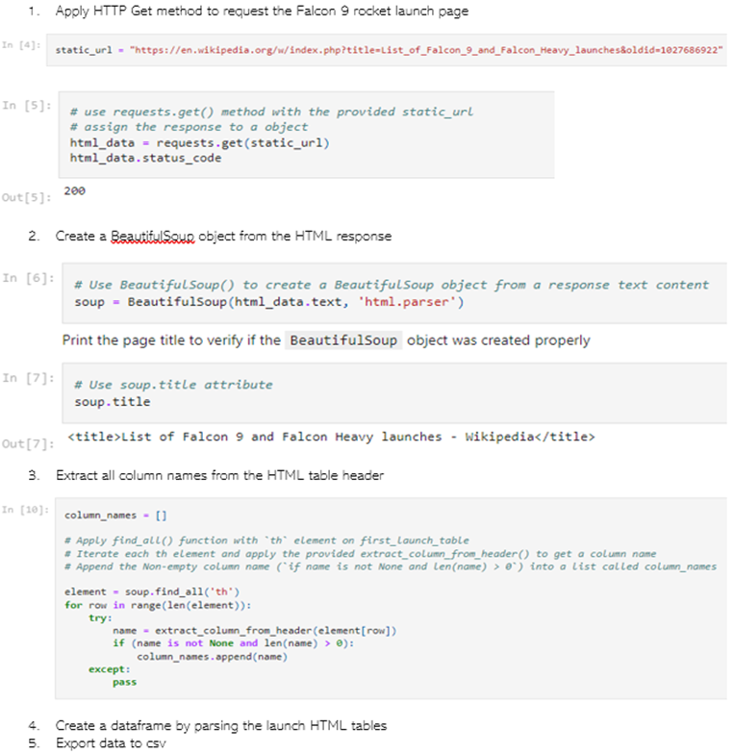
Data Collection - Scraping
Web scraping was applied to get Falcon 9 launch records with BeautifulSoup
The table was parsed and converted to a pandas dataframe.
The link to the notebook is https://github.com/KeeObom/Applied-Data-Science-Project/blob/master/Data%20Collection%20API.ipynb
Place your flowchart of web scraping here

Slide 10

Data Wrangling
We performed exploratory data analysis and determined the training labels.
We calculated the number of launches at each site, and the number of occurrence of each orbits
We created landing outcome label from outcome column and exported the results to csv
The link to the notebook is https://github.com/KeeObom/Applied-Data-Science-Project/blob/master/labs-jupyter-spacex-Data%20wrangling.ipynb

Slide 11


EDA with Data Visualization
We explored the data by visualizing the relationship between flight number and launch Site, payload and launch site, success rate of each orbit type, flight number and orbit type, the launch success yearly trend.
The link to the notebook is https://github.com/KeeObom/Applied-Data-Science-Project/blob/master/jupyter-labs-eda-dataviz.ipynb

Slide 12
EDA with SQL
We loaded the SpaceX dataset into a PostgreSQL database without leaving the jupyter notebook.
We applied EDA with SQL to get insight from the data. We wrote queries to find out for instance:
The names of unique launch sites in the space mission
The total payload mass carried by boosters launched by NASA (CRS)
The average payload mass carried by booster version f9 v1.1
The total number of successful and failure mission outcomes
The failed landing outcomes in drone ship, their booster version and launch site names.
The link to the notebook is https://github.com/KeeObom/Applied-Data-Science-Project/blob/master/jupyter-labs-eda-sql-coursera_sqllite.ipynb

Slide 13
Build an Interactive Map with Folium
We marked all launch sites, and added map objects such as markers, circles, lines to mark the success or failure of launches for each site on the folium map.
We assigned the feature launch outcomes (failure or success) to class 0 and 1 .i.e., 0 for failure and 1 for success.
Using the color-labeled marker clusters, we identified which launch sites have relatively high success rate.
We calculated the distances between a launch site to its proximities. Questions such as the following were answered:
Are launch sites near railways, highways and coastlines?
Do launch sites keep certain distance away from cities?

Slide 14
Build a Dashboard with Plotly Dash
Built an interactive dashboard with Plotly clash
Plotted pie charts showing the total launches by certain launch sites
Plotted scatter plots showing the relationship between outcome and payload mass (Kg) for different booster version.
The link to the notebook is https://github.com/KeeObom/Applied-Data-Science-Project/blob/master/spacex_dash_app.py

Slide 15
Predictive Analysis (Classification)
Loaded the data using numpy and pandas, transformed the data, split our data into training and testing.
Built different machine learning models and tune different hyperparameters using GridSearchCV
Used accuracy score as the metric for our model, improved the model using feature engineering and algorithm tuning.
We found the best performing classification model
The link to the notebook is https://github.com/KeeObom/Applied-Data-Science-Project/blob/master/SpaceX_Machine%20Learning%20Prediction_Part_5.ipynb

Slide 16
Results
Exploratory data analysis results
Interactive analytics demo in screenshots
Predictive analysis results

Slide 17

Section 2

Slide 18
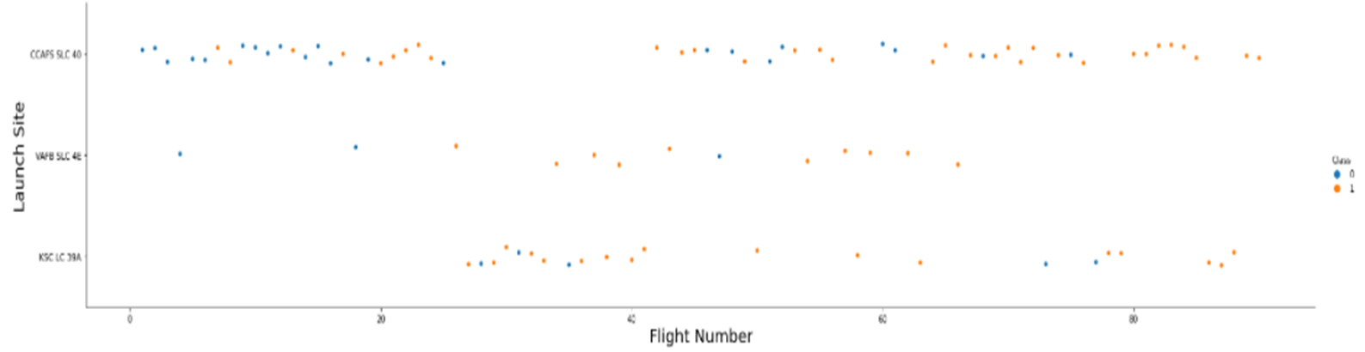
Flight Number vs. Launch Site
From the plot, it is observed that the larger the number of flights at a launch site, the greater the success rate at that launch site.

Slide 19


Payload vs. Launch Site

Slide 20

Success Rate vs. Orbit Type
From the plot, we can see that ES-L1, GEO, HEO, SSO, VLEO had the most success rate.

Slide 21

Flight Number vs. Orbit Type
The plot below shows the Flight Number vs. Orbit type. We observe that in the LEO orbit, success is related to the number of flights whereas in the GTO orbit, there is no relationship between flight number and the orbit.

Slide 22
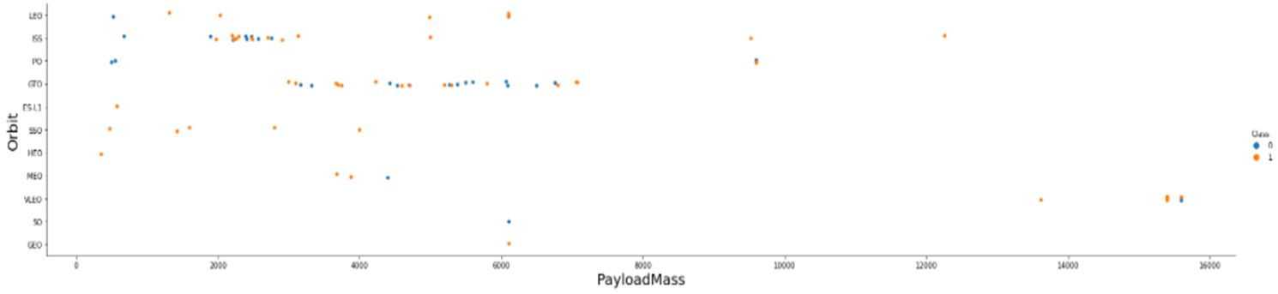
Payload vs. Orbit Type
It is observed that with heavy payloads, the successful landing are more for PO, LEO and ISS orbits.

Slide 23
Launch Success Yearly Trend
From the plot, we can observe that success rate since 2013 kept increasing till 2020.

Slide 24

All Launch Site Names
The keyword DISTINCT is used to show only unique launch sites from the SpaceX data.

Slide 25

Launch Site Names Begin with 'CCA'
The query below displays 5 records where launch sites begin with ‘CCA’

Slide 26

Total Payload Mass
Calculated the total payload carried by booster from NASA as 45596 using the query below

Slide 27

Average Payload Mass by F9 v1.1
Calculated the average payload mass carried by booster version F9 v1.1 as 2928.4

Slide 28

First Successful Ground Landing Date
It is observed that the dates of the first successful landing outcome on ground pad was 22nd December 2015

Slide 29

Successful Drone Ship Landing with Payload between 4000 and 6000
We used the WHERE clause to filter boosters which have successfully landed on drone ship and applied the AND condition to determine successful landing with payload mass greater than 4000 but less than 6000

Slide 30

Total Number of Successful and Failure Mission Outcomes
The wildcard ‘%’ is used to filter for WHERE MissionOutcome is a success or a failure.

Slide 31

Boosters Carried Maximum Payload
It has been determined that the booster have carried the maximum payload using a subquery in the WHERE clause and the MAX() function.

Slide 32

2015 Launch Records
The combinations of WHERE clause, LIKE, AND, and BETWEEN conditions to filter for failed landing outcomes in drone ship, their booster versions, and launch site names for year 2015

Slide 33

Rank Landing Outcomes Between 2010-06-04 and 2017-03-20
We selected Landing outcomes and the COUNT of landing outcomes from the data and used the WHERE clause to filter for landing outcomes BETWEEN 2010-06-04 to 2010-03-20.
We applied the GROUP BY clause to group the landing outcomes and the ORDER BY clause to order the grouped landing outcome in descending order.

Slide 34

Section 3

Slide 35

All launch sites global map markers
Replace <Folium map screenshot 1> title with an appropriate title
Explore the generated folium map and make a proper screenshot to include all launch sites’ location markers on a global map
Explain the important elements and findings on the screenshot

Slide 36

Markers showing Launch sites with color lables
Replace <Folium map screenshot 2> title with an appropriate title
Explore the folium map and make a proper screenshot to show the color-labeled launch outcomes on the map
Explain the important elements and findings on the screenshot

Slide 37

Launch Site distance to landmarks

Slide 38

Section 4

Slide 39

Pie chart showing the success percentage achieved by each launch site
Replace <Dashboard screenshot 1> title with an appropriate title
Show the screenshot of launch success count for all sites, in a piechart
Explain the important elements and findings on the screenshot

Slide 40

Pie chart showing the Launch site with the highest launch success ratio

Slide 41

Scatter plot of Payload vs Launch Outcome for all sites, with different payload selected in the range slider

Slide 42

Section 5

Slide 43

Classification Accuracy
The Decision tree classifier is the model with the highest classification accuracy

Slide 44

Confusion Matrix
The confusion matrix for the decision tree classifier shows that the classifier can distinguish between the different classes. The major problem is the false positives .i.e., unsuccessful landing marked as successful landing by the classifier.

Slide 45
Conclusions
We can conclude that:
The larger the flight amount at a launch site, the greater the success rate at a launch site.
Launch success rate started to increase in 2013 till 2020.
Orbits ES-L1, GEO, HEO, SSO, VLEO had the most success rate.
KSC LC-39A had the most successful launches of any sites.
The Decision tree classifier is the best machine learning algorithm for this task.

Slide 46


